Slide 1
Multiple scattering
ISIS Mantid Scientific Steering Committee
Break-out session
Anders Markvardsen, ISIS Facility, June 2018

Slide 2
Agenda
What multiple scattering support is available via Mantid
What has been tested
What is missing
Discussion and questions

Slide 3
Code within Mantid
Incoherent (vanadium) and cylinder geometry
MayersSampleCorrection
MultipleScatteringCylinderAbsorption : Carpenter (faster than above)
Recently changed name to CarpenterSampleCorrection
Flat and Cylindrical geometry general S(Q,w)
MuscatSofQW
Old FORTRAN, not even understandable by Spencer or others who have attempted
Trusted by a few users
Available from Windows in Mantid
VESUVIO
VesuvioCalculateMS
J Mayers (check) code translated
No geometry
Specific to VESUVIO
Notes:
Mayers performs the integration for attenuation of a single scattered neutron and then simulates a load of second scattering events to produce a ratio between second and first order scattering which is then assumed constant between orders
MSCA uses power series approximations for both corrections
Only noticed Muscat this week, not had much time to look at it. Written in FORTRAN. Will mention this again in relation to McStas

Slide 4

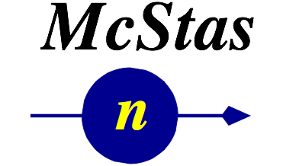
Support through other software
LoadMcStas

Slide 5
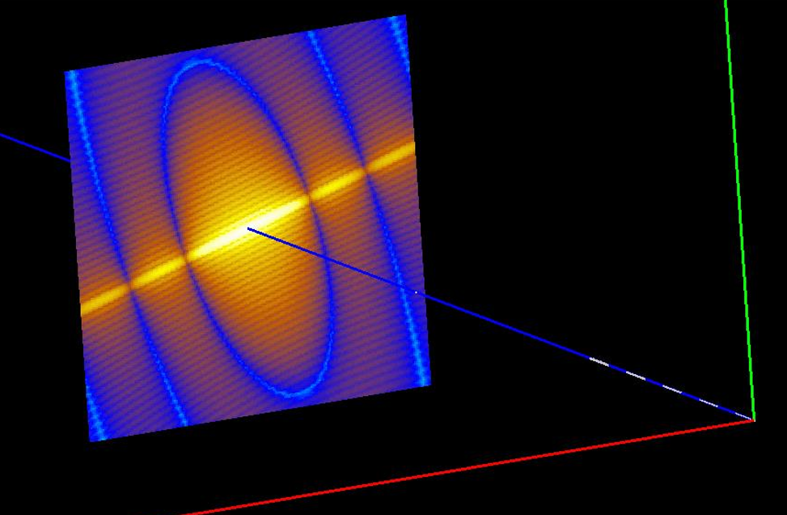
http://docs.mantidproject.org/nightly/algorithms/LoadMcStas-v1.html
Notes:
Take instrument design one step further
Pre-experiment analysis
Multiple scattering for general geometries?

Slide 6
General expectation…?
For where speed and frequency is important
Need for code within Mantid higher
Where the above less important
Stronger case for interfacing with existing multiple scattering supporting software than replicated existing software functionality

Slide 7
What MS support does McStas have on offer
Single component (e.g. the sample)
Any geometry
Powder/single crystal S(Q)
Isotropic S(Q,w)
Experimental code for general S(Q,w)
Any combination of components (called Union in McStas)
Each item any geometry
Powder/single crystal S(Q)
Incoherent scatter (e.g. Vanadium)

Slide 8
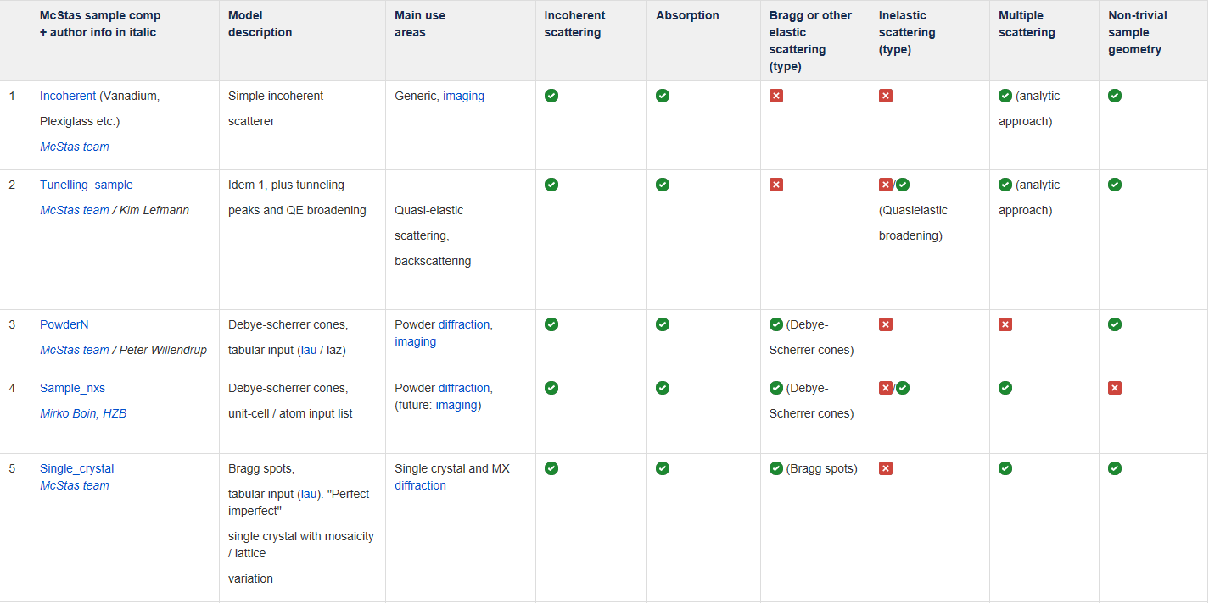
Status of the McStas sample components, sep 2015

Slide 9
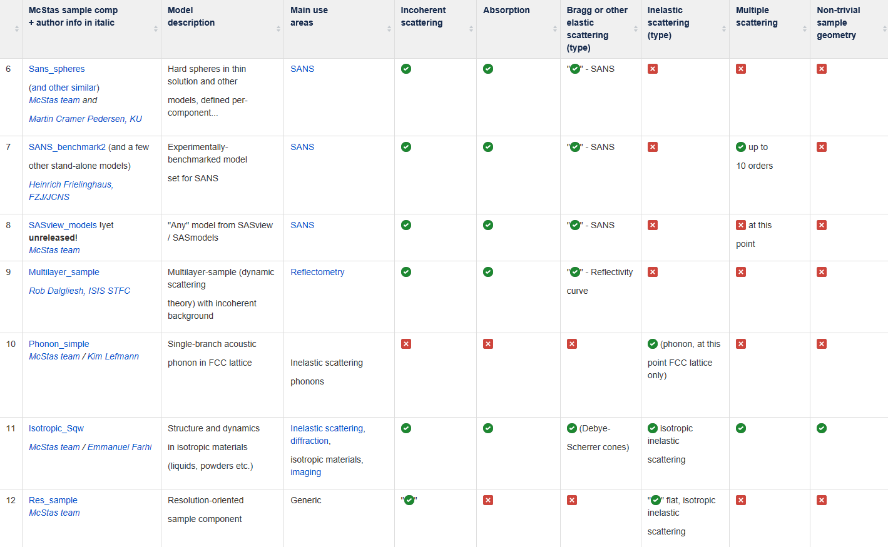

Slide 10
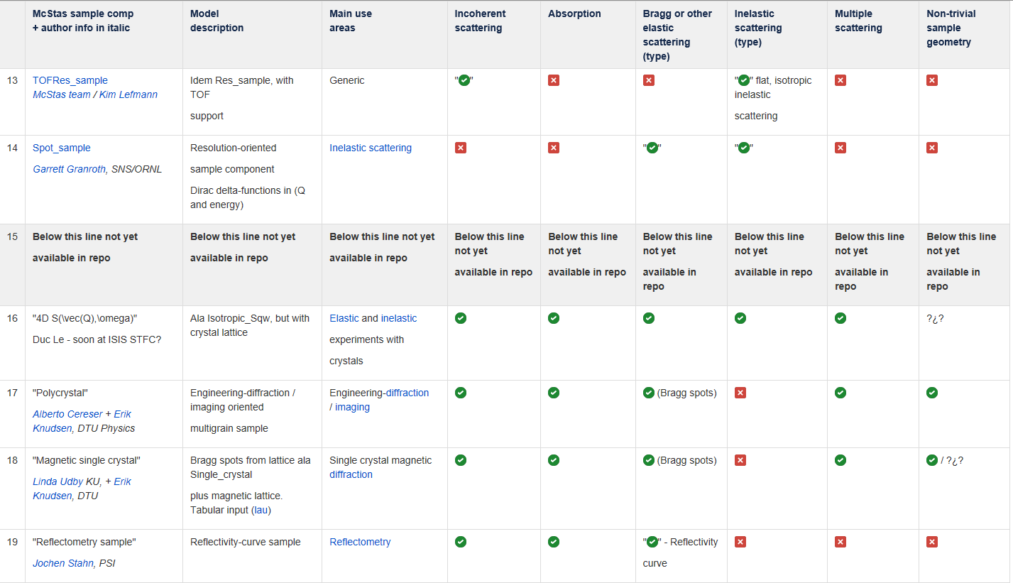

Slide 11
What has been tested

Slide 12
Investigation Mantid/McStas multiple scattering against vanadium
Report by summer student James Tricker 2017: https://github.com/mantidproject/documents/blob/master/Presentations/Multiple%20Scattering%20Presentation/Investigating%20multiple%20scattering%20with%20McStas.docx
-> Note, all/most shortcomings discussed in report have been addressed since he left

Slide 13
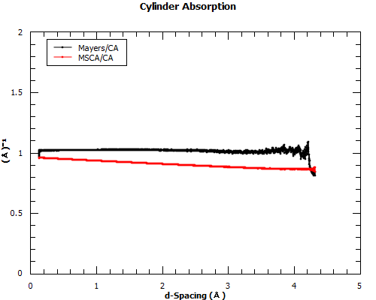
Notes:
Since both separate the correction into two factors, absorption and multiple scattering, decided to test the absorption correction first. Preexisting analytic algorithm cylinder absorption (CA) well trusted by Mantid, been tested in other cases and been tested against similar Monte Carlo algorithms. Mayers quite grainy especially zoomed in. Could increase integration steps. MSCA slanted. Assumes out of plane scattering.

Slide 14
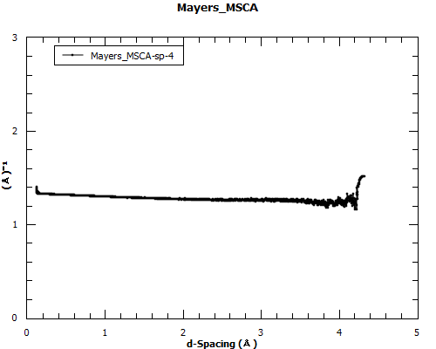
Full comparison
Notes:
Simply divided the two algorithms. Apart from scaling factor and slight slope due to cylinder absorption correction differences the algorithms seem to agree which is reassuring considering they use different methods to calculate the correction.

Slide 15
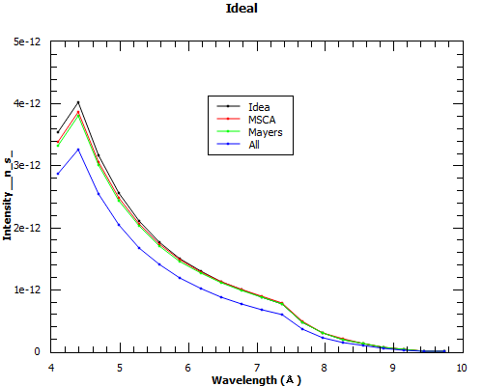
Vanadium testing with McStas and Mantid
Notes:
Ran a simulation with a cylindrical sample of vanadium and split the output into a single and all workspace. Applied the corrections to the All workspace and also did a cylinder absorption correction on the single workspace to get rid of any attenuation effects to give us a comparison workspace called Ideal.

Slide 16
Other testing: McStas
isotropic_sqw by Emmanuel
Union geometry with diffraction and incoherent components by Mads
At ISIS cloud/Linux instant with McStas/Mantid setup – waiting for a volunteer with time!

Slide 17
Other testing: McStas – Mantid interface
As originally agreed with members of the ISIS spec group: Cloud/Linux instant with McStas/Mantid available and ready – just waiting for a volunteer with time!

Slide 18
Going back to the agenda of this meeting
What multiple scattering support is available from Mantid
What has been tested
What is missing
Discussion and questions

